Slide 1
Programming with B4X
Lesson 10 – B4XPages
Anywhere Software
Feb 2021

Slide 2
Today you will learn
What is a B4XPage
How to Create and Delete a B4XPage
Passing Values within Pages

Slide 3
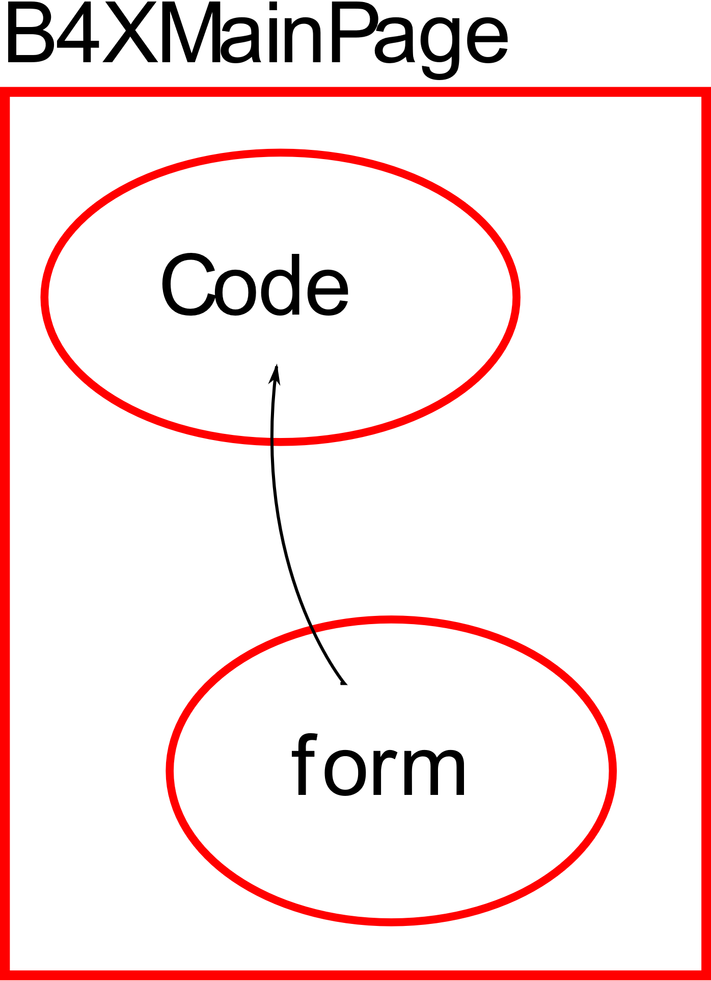
What is a B4XPage
B4XPages is a software library
Includes
Classes
&
Procedures
Also, it helps to transfer applications to different platforms using the B4A, B4i and B4J tools.
Notes:
B4XPages is a software library. Includes classes and procedures to create multiple application communication forms with the user. Also, it helps to transfer applications to different platforms using the B4A, B4i and B4J tools.
Every application you have created so far with B4J already includes a B4XPage. This is B4XMainPage which is always the user's first contact form with the application. More generally, each B4XPage manages all the codes required for the GUI (Graphics User Interface) to work.

Slide 4
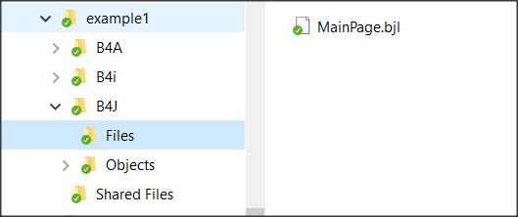
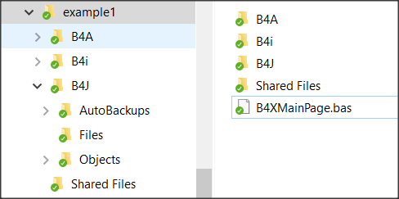
The structure of an application's folders
Each of the three folders B4A, B4i And B4J include the relevant codes in order to create applications, Android, IOS, computers (Windows, Linux platforms) respectively.
The application's home folder contains all the files that create the different B4XPages of our application.
The first page that is created must have the name “B4XMainPage.bas” and cannot be changed; all other pages are named by the developer.
Notes:
When you start a new program with B4XPage, the following folder structure is created.
Each of the three folders B4A, B4i And B4J include the relevant codes in order to create applications, Android, Ios computers (Win-dows, Linux platforms) respectively.
Specifically, in the B4J folder there is the “Files” folder where it contains all the files created with the Designer as well as any other files that must be used during the execution of the code e.g. images. MainPage.bjl is the file that was created automatically during the creation of the application and is its home screen. The Shared Files folder also includes files that the three dif-ferent applications can share if the developer chooses to create an applica-tion for both Android, IOS and PC.
The application's home folder contains all the files that create the different B4XPages of our application.
The first page that is created must have the name “B4XMainPage.bas” and cannot be changed; all other pages are named by the developer.

Slide 5
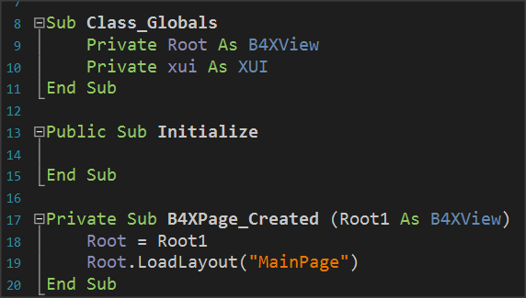
Starting an application with B4XPage.
Notes:
When creating a new application with B4Xpage, the language has already prepared the first page and as mentioned its name in the application folder is B4XMainPage.bas. Also, it has created a form (or GUI screen) to com-municate with the user (named MainPage.bjl). Eventually, a mechanism called B4XPagesManager undertakes to manage the pages.
What is Root
The Root variable is an object of class B4XView. Undertakes to perform all display-related tasks in the various forms created by the developer (also associated with code sharing in B4J, B4A, B4i). Therefore, the Root object instructs the MainPage form to load with the Root.LoadLayout("MainPage" method).

Slide 6
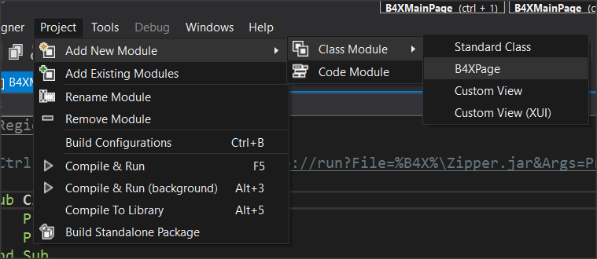
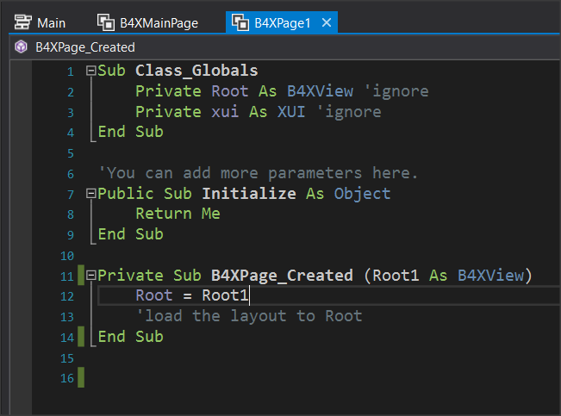

Create a new B4XPage, step 1
Give the name B4XPage1
Notes:
After Create an app select from the menu Project – Add New Module – Class Module – B4XPage And Give the name B4XPage1.
A class with a name “B4XPage1” will be created, and some necessary codes to get started. The user communication screen (GUI) has not yet been created at this point. This should be done by the Designer later

Slide 7
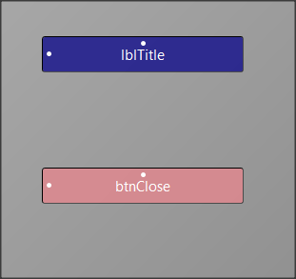
Create a new B4XPage, step 2
use designer to create this screen
Notes:
Open Designer and from the menu File select New.
From the Variants tab, specify the dimensions of the form you want to design, and then select a label and button to insert into your form

Slide 8
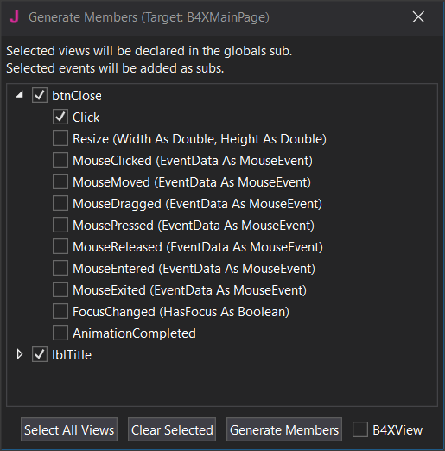
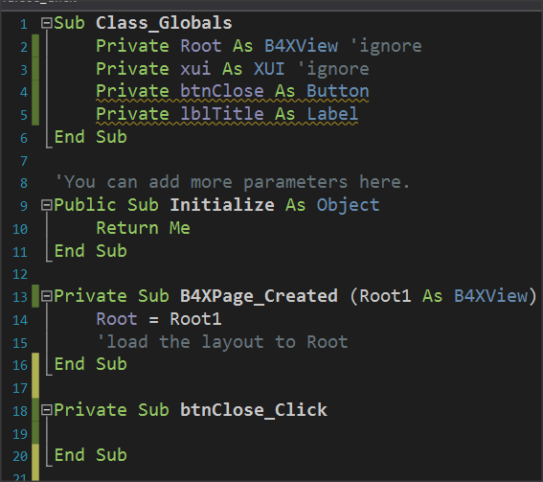
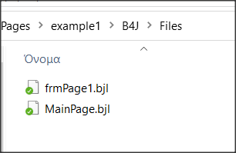
Create a new B4XPage, step 3
Save as frmPage1
Notes:
Use the menu Generate Members to insert the two objects into your code as well as the Click of the button. Remember that this action must be applied when you are in the code of the B4XPage1.
From the file menu save your form named frmPage1. (You can give any name you want, and it serves the needs of the application).
The following code will now be created, and the file will have been displayed frmPage1.bjl in the folder files.

Slide 9
Create a new B4XPage, step 4
Private Sub B4XPage_Created (Root1 As B4XView)
Root = Root1
Root.LoadLayout(“frmPage1”)
End Sub
Notes:
To link the form frmPage1 with the B4XPage1 you must now call the property Root.LoadLayout("frmPage1") within the event B4XPage_Created. The next steps include method’s programming and depend on the purpose of the application you are building.
In our example, suppose you want to move to the B4XPage1 screen with one click in B4XmainPage’s button and then click the button you placed to return to the home page.

Slide 10
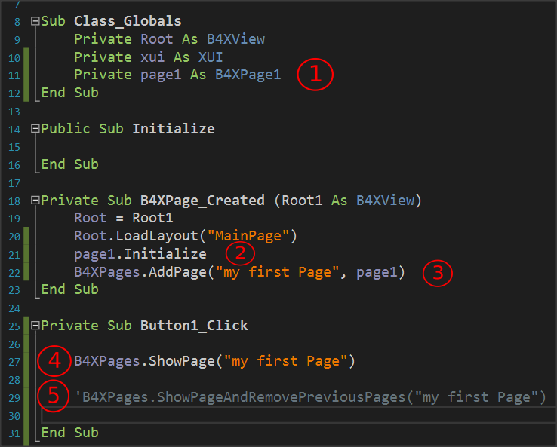
Call a new B4Xpage.
Set a class object B4XPage1. Initialize page1.
Runs the Initialize routine within class B4XPage1.
Create an ID for the new page object. (In the example is "my first Page")
Call the new page while the home page remains open.
Second way to call a page where the home screen closes and only the new page remains open.
Notes:
Set a class object B4XPage1. Initialize page1.
Runs the Initialize routine within class B4XPage1.
Create an ID for the new page object. (In the example is "my first Page")
Call the new page while the home page remains open.
Second way to call a page where the home screen closes and only the new page remains open.

Slide 11
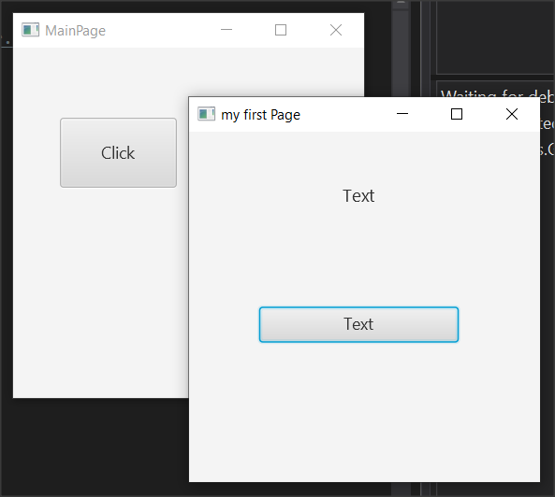
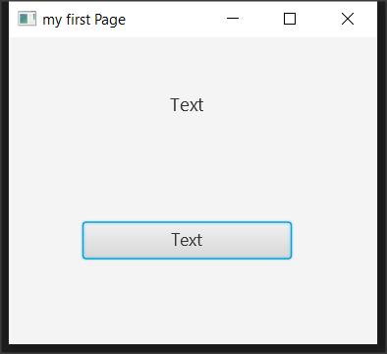
Call a new B4Xpage.

Slide 12
Close a B4XPage.
When opened with: | Usually closes with:
B4XPages.ShowPage("my first Page") | B4XPages.ClosePage(Me)
B4XPages.ShowPageAndRemovePreviousPages("my first Page") | B4XPages.ShowPageAndRemovePreviousPages("MainPage")
Notes:
When a B4XPage is called, the program control passes to that page. There-fore, for the page to close, an event must occur, such as pressing a button or the close button in the top right of the window. More generally, it also depends on how the screen was opened:
The first way closes the current form while the second way essentially calls the home page again while closing the current one.

Slide 13
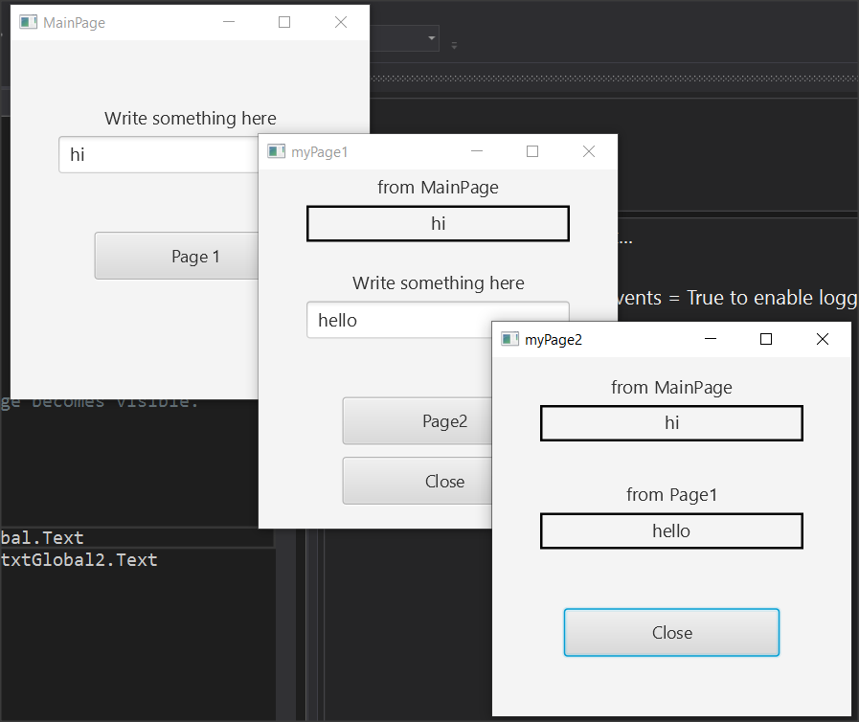
Transfer information between pages
Notes:
For one page to have access to data from another, those pages must have variables declared with the keyword Public. The pages objects themselves when they are created either in the MainPage or elsewhere have also been declared as Public.
For the purposes of this example, you will use the application of example 2. This includes MainPage, B4XPage1 and B4XPage2. Forms have also been created in the Designer. Open example 2, run it, and observe its operation.

Slide 14
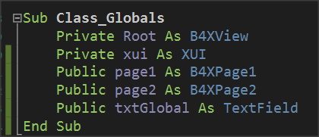
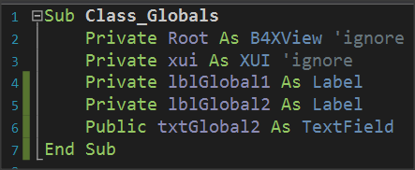
Transfer information between pages
lblGlobal1.Text = B4XPages.MainPage.txtGlobal.Text
Page1
MainPage
lblGlobal1.Text = B4XPages.MainPage.txtGlobal.Text
lblGlobal2.Text = B4XPages.MainPage.page1.txtGlobal2.Text
Notes:
As you run the application, notice that text from textFields is transferred to the following pages. This is because both page1 and page2 and both TextField are declared public.
In order page1 to have access to the txtGlobal1 variable, it must also use it by indicating the name of the page on which it was created:
lblGlobal1.Text = B4XPages.MainPage.txtGlobal.Text
where lblGlobal1 is a label that displays the content read on the page1 screen.
Similarly, Page2 has access to MainPage's txtGlobal1 and Page1's txtGlobal2 variables as follows:
lblGlobal1.Text = B4XPages.MainPage.txtGlobal.Text
lblGlobal2.Text = B4XPages.MainPage.page1.txtGlobal2.Text
where lblGlobal1 and lblGlobal2 are two labels that display the contents of the two Public Variables on the page2 screen.

Slide 15
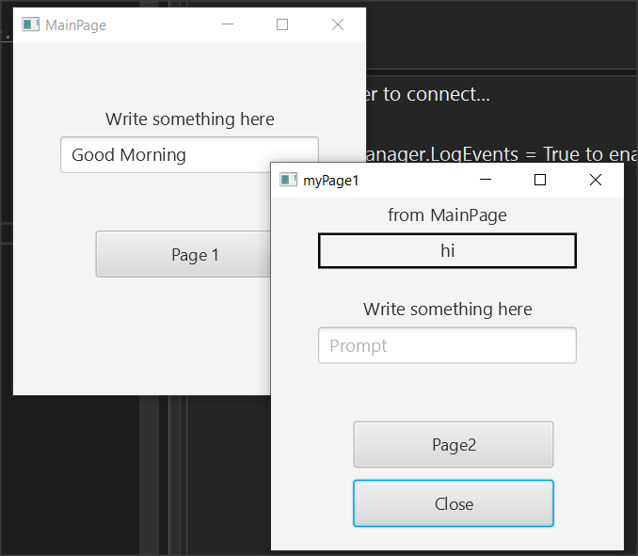
The Life of B4XPages
Private Sub B4XPage_Appear
lblGlobal1.Text = B4XPages.MainPage.txtGlobal.Text
End Sub
Notes:
In the previous example, try closing all windows except MainPage and type in new text and press the button to page1. You will notice that the value displayed by the MainPage it is not the new but still shows the first one.
This is because B4Xpages remain in computer memory and each time they are called the event B4XPage_Create does not run again. To read the global variables again from MainPage you can run event B4XPage_Appear and in there use the variables from MainPage:
Unlike B4XPage_Create that runs only once on the first call of the page, B4XPage_Appear runs every time the window appears in the foreground, so you can use it whenever the page returns to transfer variables from other forms.

Slide 16
Thank you!!!
Photos taken From:

